Slide 1

CMR COLLEGE OF ENGINEERING & TECHNOLOGY
Kandlakoya, Medchal, Hyderabad - 501401
Department of Computer Science and Engineering
Fake Face Detector
K. LOKESH REDDY 19H51A0514
B. VISHNU VARSHITHA 19H51A0565
I. SUMANTH 19H51A05K4
Under esteemed guidance of
Mr. T.UPENDER

Slide 2
Outline
Abstract
Introduction
Research Objective
Problem Definition
Project Scope and Limitations
Conclusion
References
Notes:
2

Slide 3
ABSTRACT
Face recognition is a widely used biometric approach. Face recognition technology has developed rapidly in recent years and it is more direct, user friendly and convenient compared to other methods. But face recognition systems are vulnerable to spoof attacks made by non-real faces. It is an easy way to spoof face recognition systems by facial pictures such as portrait photographs. A secure system needs Liveness detection in order to guard against such spoofing. In this work, face liveness detection approaches are categorized based on the various types techniques used for liveness detection. This categorization helps understanding different spoof attacks scenarios and their relation to the developed solutions. A review of the latest works regarding face liveness detection works is presented. The main aim is to provide a simple path for the future development of novel and more secured face liveness detection approach.

Slide 4
Introduction
Face recognition, as one of the computer vision techniques has been successfully applied in a variety of applications in the real life.
Although much convenience is brought by the face recognition technique, many kinds of face presentation attacks also appear.
Deep Learning can be employed to identify real or fake images/faces/videos efficiently.
In this project, we propose an approach that takes an image as input and classifies it, using an effective system (the CNN model).
The result of this project in which the images are fed into the detector, and it will then detect whether the image that is fed into it is real or fake.
Notes:
4

Slide 5
Research objective
Face recognition systems are easily fooled by “spoofing” and “non-real” faces.
Face recognition systems can be fooled simply by holding up a photo of a person (whether printed, on a smartphone, etc.) to the face recognition camera. In order to make face recognition systems more secure, we need to be able to detect such fake/non-real faces.
Many face anti-spoofing methods have been proposed. Appearance-based methods choose to extract various appearance cues to differentiate real and fake.

Slide 6
Problem Definition
Face recognition technology is a widely used that has been developed rapidly in recent years.
But face recognition systems are vulnerable to spoof attacks made by non-real faces, photographs.
A secure system needs Liveness detection in order to guard against such spoofing.

Slide 7
Project scope
Liveness detection in biometrics is the ability of a system to detect if a fingerprint or face (or other biometrics) is real (from a live person present at the point of capture) or fake (from a spoof artifact or lifeless body part).
Liveness check uses algorithms that analyze data - after they are collected from biometric scanners and readers - to verify if the source is coming from a fake representation.

Slide 8
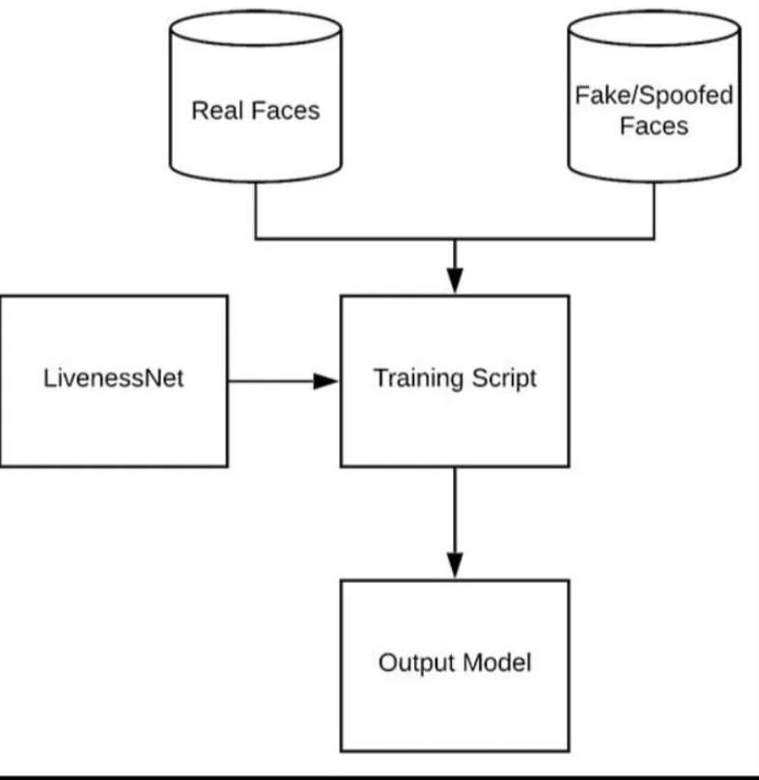
Processing Model

Slide 9
Limitation
Liveness detection algorithm’s performance degrades remarkably when it encounters unfamiliar spoof fabrication materials.
It limits their application in the real world, where the nature of attacks is unpredictable.
So, we need to develop generalized live ness detection methods that detect varying or previously unseen spoofing attacks.

Slide 10
Conclusion
This work provided an overview of different approaches of face liveness detection. It presented a categorization based on the type of techniques used and types of liveness indicator/clue used for face liveness detection which helps understanding different spoof attacks scenarios and their relation to the developed solutions. A review of most interesting approaches for liveness detection was presented. The most common problems that have been observed in case of many liveness detection techniques are the effects of illumination change, effects of amplified noise on images which damages the texture information. For blinking and movement of eyes based liveness detection methods, eyes glasses which causes reflection must be considered for future development of liveness detection solutions. Furthermore, the datasets, which play an important role in the performance of liveness detection solutions, must be informative and diverse that mimics the expected application scenarios. Non-interactive video sequences must include interactive sequences where the users perform certain tasks. Future attack datasets must consider attacks like 3D sculpture faces and improved texture information. Our main aim is to give a clear pathway for future development of more secured, user friendly and efficient approaches for face liveness detection.

Slide 11
References
A[1] G. Kim, S.Eum, J. K. Suhr, D. I. Kim, K. R. Park, and J, Kim, Face liveness detection based on texture and frequency analyses, 5th IAPR International Conference on Biometrics (ICB), New Delhi, India. pp. 67-72, March 2012.
[2] J. Maatta, A. Hadid, M. Pietikainen, Face Spoofing Detection From Single images Using Micro- Texture Analysis, Proc. International Joint Conference on Biometrics (UCB 2011), Washington, D.C., USA.
[3] sooyeon Kim, Sunjin Yu, Kwangtaek Kim, Yuseok Ban, Sangyoun Lee, Face liveness detection using variable focusing, Biometrics (ICB), 2013 International Conference on, On page(s): 1 – 6, 2013.
[4] H. K. Jee, S. U. Jung, and J. H. Yoo, Liveness detection for embedded face recognition system,International Journal of Biological and Medical Sciences, vol. 1(4), pp. 235-238, 2006.

Slide 12
Thank You!

